Slide 1
Digital product design
Lecture 4: Eliciting Consumer Preferences
Alex Moehring

Slide 2
Overview
Model of consumer choice
User studies to measure preferences
Conjoint experiments to generate choice data
Interpreting conjoint experiments

Slide 3
Introduction to User preferences

Slide 4
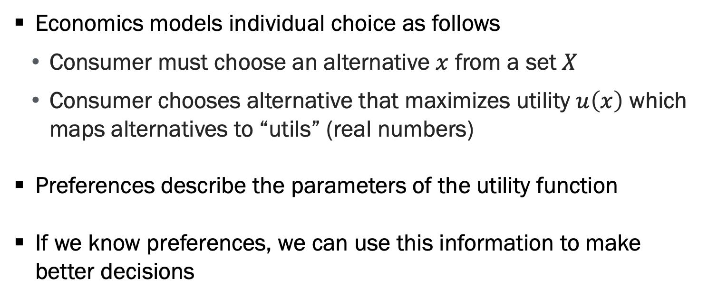
Introduction to Preferences
Economics models individual choice as follows
Consumer must choose an alternative $x$ from a set $X$
Consumer chooses alternative that maximizes utility $u\left(x\right)$ which maps alternatives to “utils” (real numbers)
Preferences describe the parameters of the utility function
If we know preferences, we can use this information to make better decisions

Slide 5

Example
$X=\{apple,banana\}$
$u\left(apple\right)=7$, $u\left(banana\right)=12$
What fruit would you choose?

Slide 6
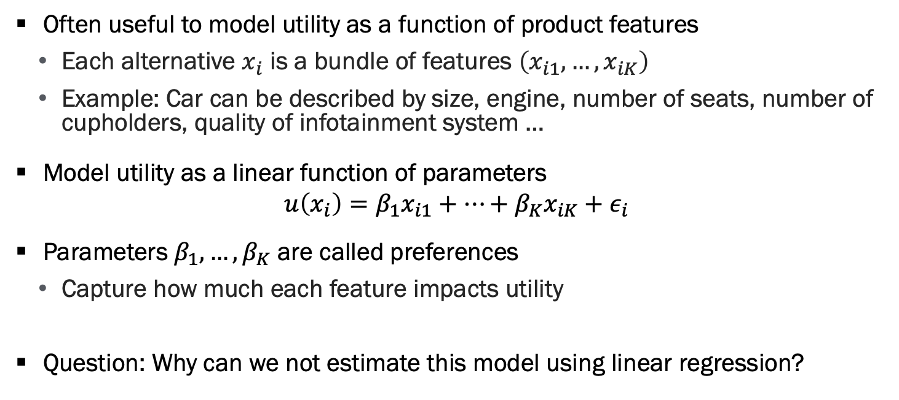
Product Features
Often useful to model utility as a function of product features
Each alternative $x_{i}$ is a bundle of features $\left(x_{i1},…,x_{iK}\right)$
Example: Car can be described by size, engine, number of seats, number of cupholders, quality of infotainment system …
Model utility as a linear function of parameters
$$u\left(x_{i}\right)=β_{1}x_{i1}+…+β_{K}x_{iK}+ε_{i}$$
Parameters $β_{1},…,β_{K}$ are called preferences
Capture how much each feature impacts utility
Question: Why can we not estimate this model using linear regression?

Slide 7
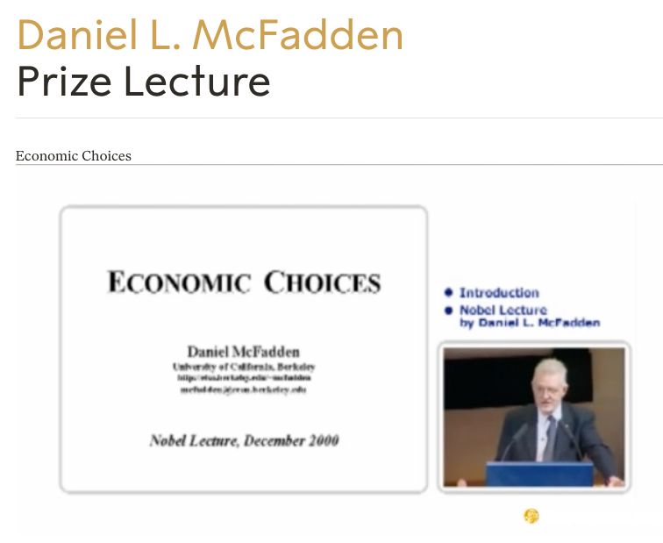
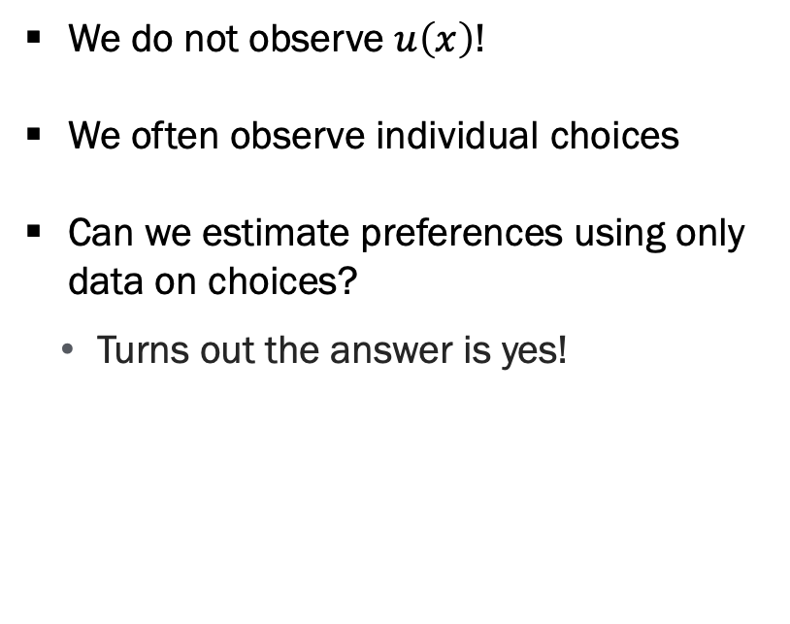
Product Features, Continued
We do not observe $u\left(x\right)$!
We often observe individual choices
Can we estimate preferences using only data on choices?
Turns out the answer is yes!

Slide 8
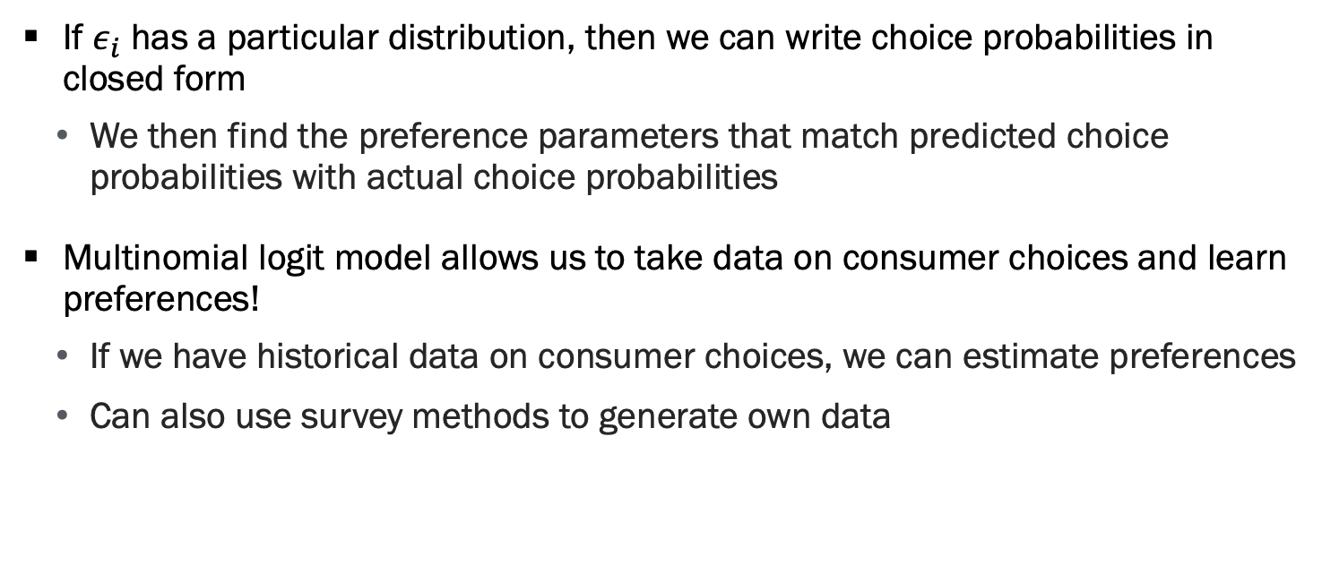
Multinomial Logit Model
If $ε_{i}$ has a particular distribution, then we can write choice probabilities in closed form
We then find the preference parameters that match predicted choice probabilities with actual choice probabilities
Multinomial logit model allows us to take data on consumer choices and learn preferences!
If we have historical data on consumer choices, we can estimate preferences
Can also use survey methods to generate own data

Slide 9
User Studies to learn customer preferences

Slide 10
Types of User Studies
Interviews: One-on-one interview with potential customers
Focus group: Moderator facilitates discussion between many customers
Observe product in use

Slide 11
Benefits of User Studies
Open ended and can be run anytime in the development process
Can help you generate new features / solutions to explore
Get to observe users using product and understand thinking

Slide 12
Downsides of User Studies
Consumers have a preference for many features
Hard to know how strong that preference is from these studies
Some risk of survey demand bias
People like to tell you things you want to hear

Slide 13
Conjoint surveys

Slide 14
Conjoint Overview
We want to measure consumer preferences from choices
Idea is to get survey responses to make choices in a simulated environment
Pros:
Easy to set up and run without building prototype
Better than asking consumers “how much do you like X feature”
Cons
Simulated choices are worse than actual choice data

Slide 15
Conjoint Overview, Continued
With data on choices, we let software to estimate preferences
This can help us:
Understand how much consumers value different attributes
Prioritize features in the development process
Understand how to price our offering
Understand how to segment our customers

Slide 16
Mechanics of Running a Conjoint
Use online software that offers “Choice Based Conjoint”
Sawtooth is a good option with a free tier
Conjointly also good but expensive
I have been told Qualtrics conjoint is not great
Specify product features and levels (important to include price)
Software automates randomization and data collection
Recruit survey participants (or use LLMs)
Software analyzes results

Slide 17
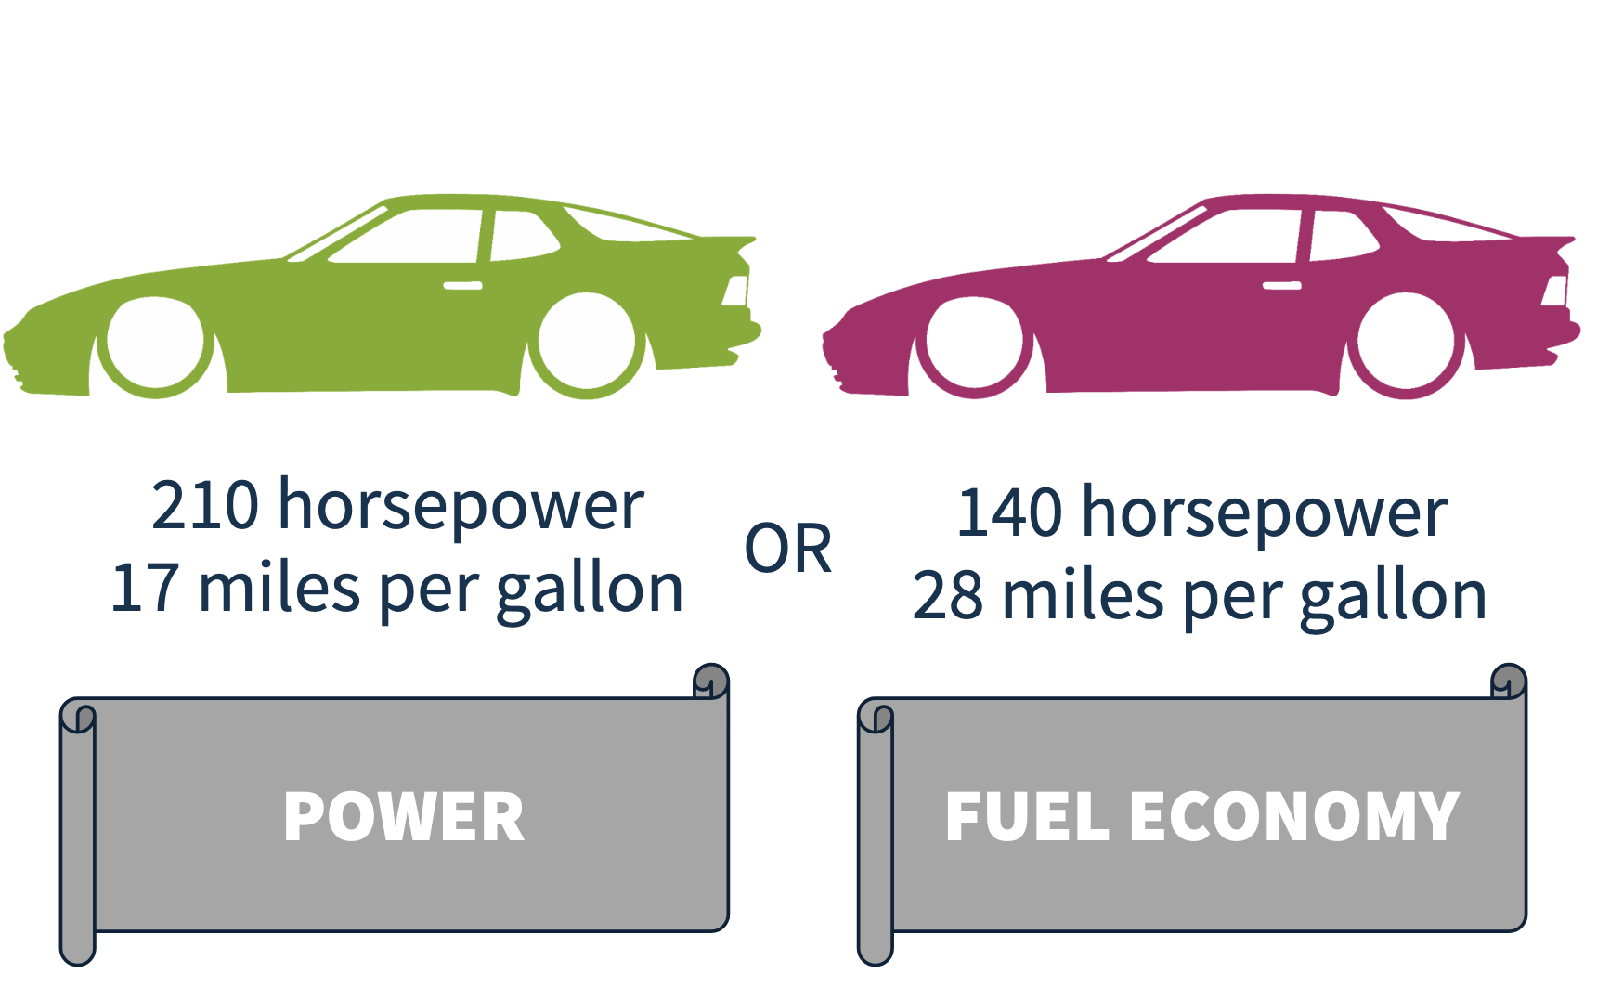
Participants Consider Several Bundles of Features
When respondents make difficult tradeoffs, we learn what they value!
Source: Sawtooth Software

Slide 18
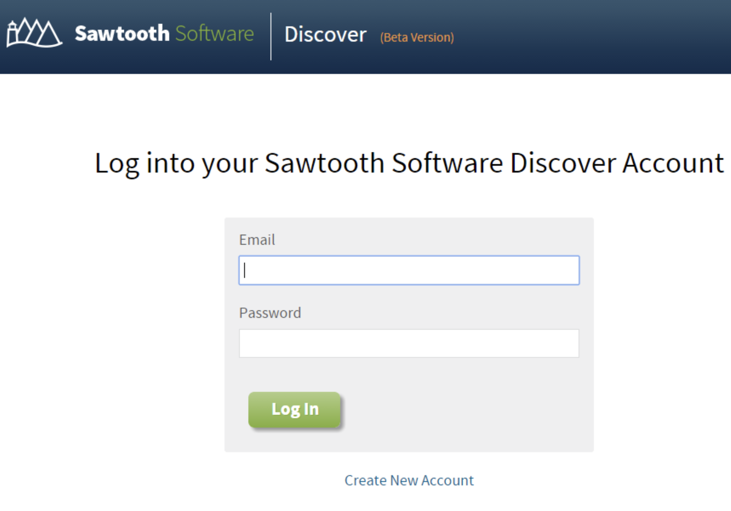
Running a Conjoint using Sawtooth

Slide 19
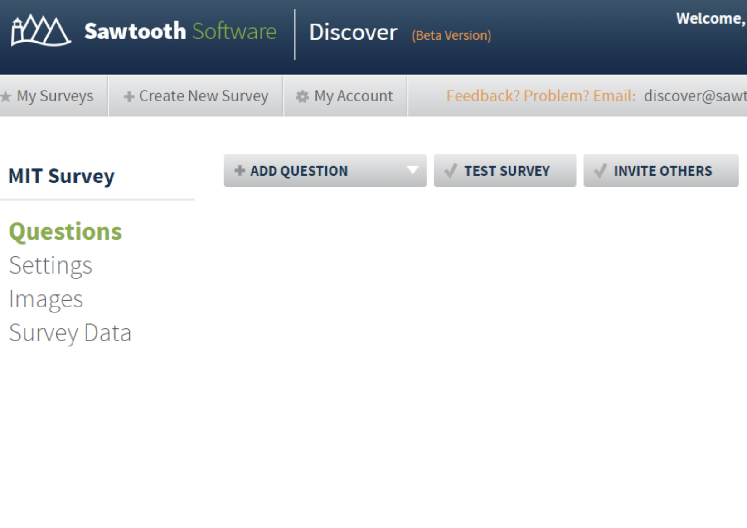
Add Choice Based Conjoint (CBC) Question

Slide 20
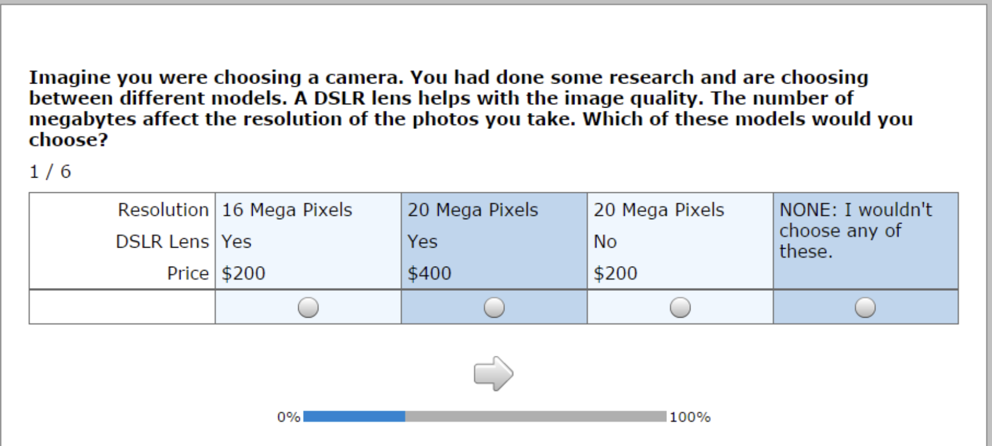
Sample Survey
Notes:
Great to add pictures, make this more realistic

Slide 21
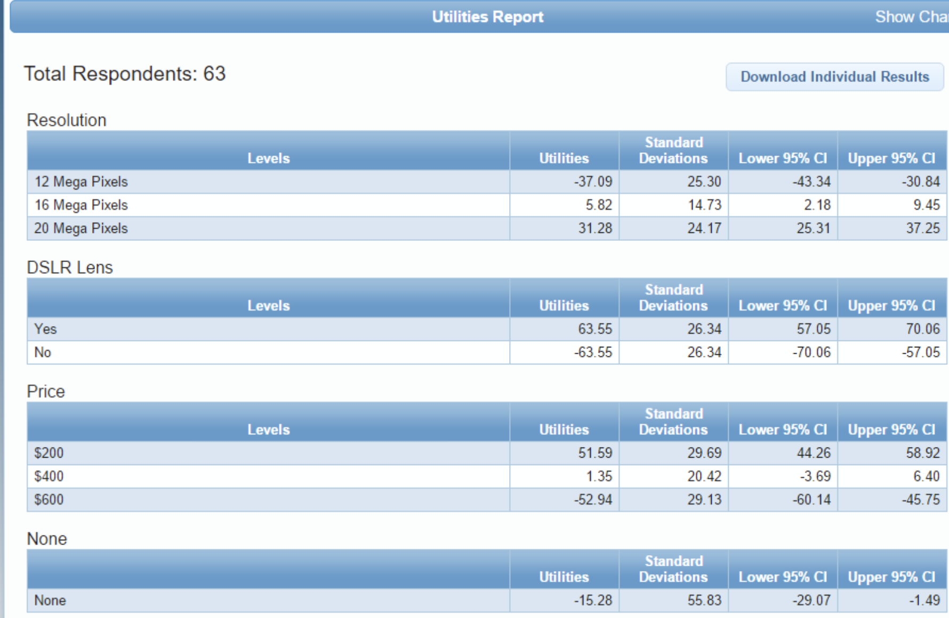
Utility Analysis
Notes:
Great to add pictures, make this more realistic

Slide 22
Calculating Dollar Value of Features
Must have price as an attribute in the conjoint
Calculate the dollar value of a util
Calculate the (relative) dollar value of features
If feature is color: green or red we can calculate dollar value of red relative to green, not the dollar value of a color
If feature is present / not present, then we can calculate dollar value of feature
Notes:
Great to add pictures, make this more realistic

Slide 23
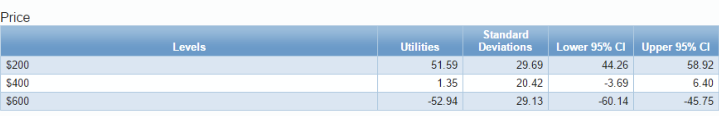
Calculating the Dollar-Value of a “Util”
First focus on the Price attribute
Changing price from $600 to $200 increases utility by 104.5 utils
$400 off price increases utility by 104.5
$1 = 0.26 utils
1 util = $3.85
Notes:
Great to add pictures, make this more realistic

Slide 24
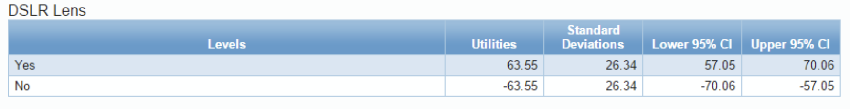
Calculating the Dollar-Value of DSLR Feature
We know 1util=$3.85
Adding SLR increases utility by 127 utils
127 utils * 3.85 dollars per util = $488 for SLR
Notes:
Great to add pictures, make this more realistic

Slide 25
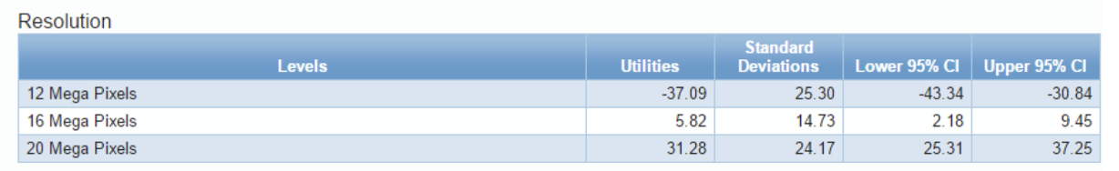
Calculating the Dollar-Value of 1MP
We know 1util=$3.85
Adding 8MPs increases utility by 68 utils
Adding 1 MP increases utility by 68/8 = 8.5 utils
8.5 utils * 3.85 dollars per util = $38 per MP
Notes:
Great to add pictures, make this more realistic

Slide 26
Practice Interpreting Conjoint Results
Company trying to sell jogging pants subscription service
Get new athletic wear monthly
Calculate dollar value of a util
Calculate dollar value of customized fit
Feature | Level | Utils
Monthly Price | $100 | 200
Monthly Price | $150 | 0
Monthly Price | $200 | -200
Customized Fit | Yes | 50
Non-Customized Fit | No | -50
Number of Jogging Pants | 1 | -30
Number of Jogging Pants | 2 | 10
Number of Jogging Pants | 3 | 20
Notes:
$1=4 utils
Dollar value of custom fit is $25

Slide 27
Practice Interpreting Conjoint Results, Continued
Calculate dollar value of extra pairs of pants
Is this linear?
What should we do given this information?
Feature | Level | Utils
Monthly Price | $100 | 200
Monthly Price | $150 | 0
Monthly Price | $200 | -200
Customized Fit | Yes | 50
Non-Customized Fit | No | -50
Number of Jogging Pants | 1 | -30
Number of Jogging Pants | 2 | 10
Number of Jogging Pants | 3 | 20
Notes:
$1=4utils
Going from 1 pant to 2 pants => 40 utils= $12
Going from 1 pant to 3 pants => 50 utils=$12.50

Slide 28
Dos and Don’ts of Conjoint Analysis
Do:
Test a broad range of prices
If we test $19.99 and $20, we will be extrapolating based off left digit biases
Better to choose $10, $20, $30
Measure demographic information for customer segmentation
Do certain types of people value different features differently
Try to find respondents who are representative of your market
Notes:
Great to add pictures, make this more realistic

Slide 29
Dos and Don’ts of Conjoint Analysis, Continued
Don’t:
use conjoint if survey-takers are ignorant about the features
use conjoint if price is a signal of the quality
use conjoint with highly correlated features
E.g. if product is car, cannot have both features:
Type: coupe / mini-van
Number of seats: 2, 4, 8
calculate dollar value of utils if price relationship is highly non-linear
Notes:
Great to add pictures, make this more realistic

Slide 30
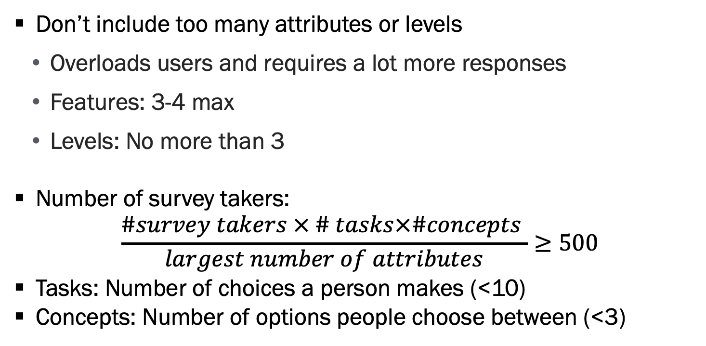
Final Points
Don’t include too many attributes or levels
Overloads users and requires a lot more responses
Features: 3-4 max
Levels: No more than 3
Number of survey takers:
$$\frac{\#survey takers × \# tasks×\#concepts }{largest number of attributes}≥500$$
Tasks: Number of choices a person makes (<10)
Concepts: Number of options people choose between (<3)
Notes:
Great to add pictures, make this more realistic

Slide 31
Finding participants

Slide 32
Finding Participants for Surveys
Actual customers
Social media
Paid panels
Simulated AI respondents
Notes:
Great to add pictures, make this more realistic

Slide 33
Actual Customers
Pro:
Representative of your customer segment
Cons:
May get confused seeing features that don’t currently exist
Cannot send person many surveys, risk of exhausting the pool
Notes:
Great to add pictures, make this more realistic

Slide 34
Social Media
Two strategies:
Post your survey, try to get your community to participate and share
Called snow-ball sampling
Paid advertising
Pro:
Often cheaper than paid panels (sometimes free!)
Gets feedback from most engaged customers
Cons:
Often a non-representative sample
Notes:
Great to add pictures, make this more realistic

Slide 35
Paid Panels
Companies pay individuals to take surveys / polls
Examples: Harris, Nielson, Yougov, …
Pros
Can get samples representative on many important dimensions
Some quality control exists
Cons
Can be very expensive (think >$10 per response)
Risk of using “professional” survey takers
Notes:
Great to add pictures, make this more realistic

Slide 36
LLMs
Ask ChatGPT or your LLM of choice to choose between alternatives
Pros
Inexpensive to collect a lot of data
Cons
Lack of understanding of when these mimic human responses
Evidence that responses are sensitive to prompt
Notes:
Great to add pictures, make this more realistic

Slide 37
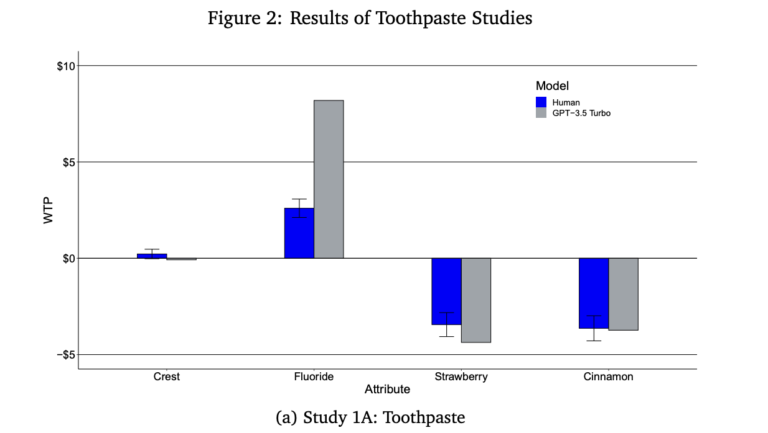
LLMs vs Human Participants
Source: Brand et al (2024)
Notes:
Great to add pictures, make this more realistic

Slide 38
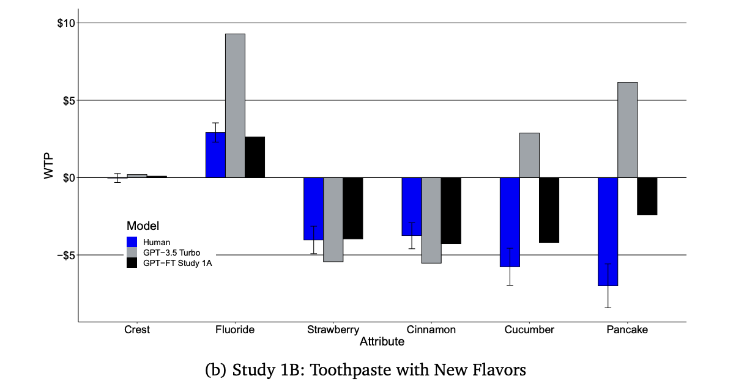
LLMs vs Human Participants, Continued
Source: Brand et al (2024)
Notes:
Great to add pictures, make this more realistic

Slide 39
Takeaway
LLMs are a great way to do a rough cut of your survey
There is still a lot to learn about when these results are reliable
Should we invest in pancake toothpaste?
Results are better with well-known products / features
Some evidence that fine-tuning models can improve performance
Risky to rely only on these models at this point
Notes:
Great to add pictures, make this more realistic

Slide 40
Questions

Slide 41
Purpose of Conjoint Surveys
Conjoints give us a method to measure the value of features
Can do this for different customer segments
Helps us:
Prioritize development of most valuable features
Price our offering and segment the market
Notes:
Great to add pictures, make this more realistic

Slide 42
Next Time
No Class Thursday
Each group signs up for a project check-in meeting (~10 minutes)
https://calendar.app.google/er8YzgovSxjgj1JM8

